Slide 1
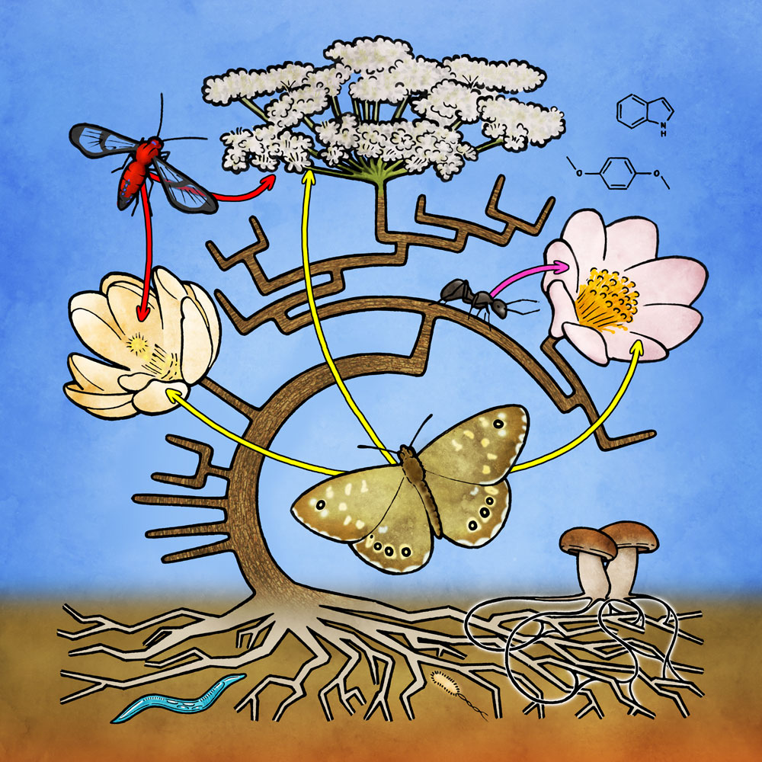
43rd New Phytologist Symposium
Interaction networks and trait evolution
1 – 4 July 2019
Zürich, Switzerland
Speakers
Marcelo Aizen
Jordi Bascompte
Judith Bronstein
Diane Campbell
José María Gómez Reyes
Catherine Graham
Pedro Jordano
Toby Kiers
Anton Pauw
Shoko Sakai
Florian P. Schiestl
Sharon Strauss
John N. Thompson
Jason Tylianakis
Miguel Verdú
Organising committee
Jordi Bascompte
Florian P. Schiestl
Grant application deadline
28th March 2019
Poster abstract deadline
25th April 2019
Register online:
newphytologist.org/symposia/43
@NewPhyt
#43NPS
fb.com/NewPhytologist

