Slide 1
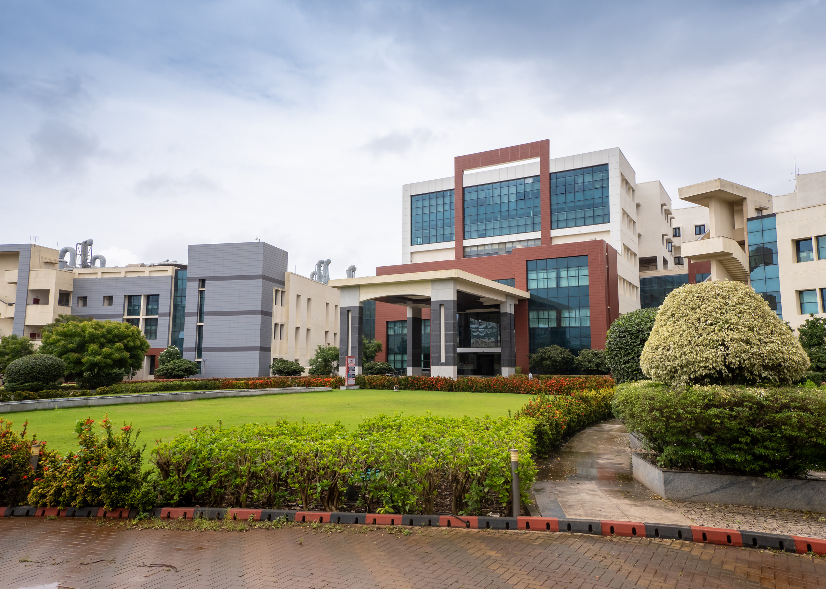

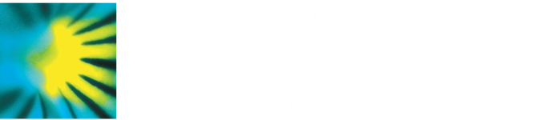
For early career researchers including graduate students and researchers up to five years post-PhD.
Applications will open in Spring 2026
To apply, applicants will need to provide:
A poster abstract that reflects your current research interests.
A personal statement of 200 words.
A curriculum vitae.
A letter of recommendation / reference from a scientist who has agreed to support your application, usually your group leader or someone who knows your work well.
newphytologist.org/events/2026-ngs
1–4 December 2026
IISER Pune, India

